Slide 1
Hurricane Harvey – Track Analysis
Data Analytics & Visualization 2020

Slide 2
Project Information
Project Team (Group 6):
Reza Abasaltian, Vincent Adams, Jeremy Jones, & Rob Pascarella
Project Scope:
As a group we have decided to gather data from offshore weather stations and platforms to perform an analysis of weather attributes as they correlate to the intensity of Hurricane Harvey.
Weather attributes analyzed:
Wind Speed (m/s); as our measure of intensity
Water Salinity (PSU)
Air Pressure (mBar)
Water Temperature (°C)
Air Temperature (°C)

Slide 3
Questions
What weather attributes contributed the most, if any, to the intensity of Hurricane Harvey?
Did water temperature affect intensity of the hurricane the most?
Did air temperature affect the intensity of the hurricane the most?
Did air pressure affect the intensity of the hurricane the most?
Did water salinity affect the intensity of the hurricane the most?
How will this problem be attacked?
We plan to answer these questions by utilizing various statistical analyses. Graphically, we will represent our data in scatter plots to show correlations as well as box plots to show our outliers in within each data set.

Slide 4
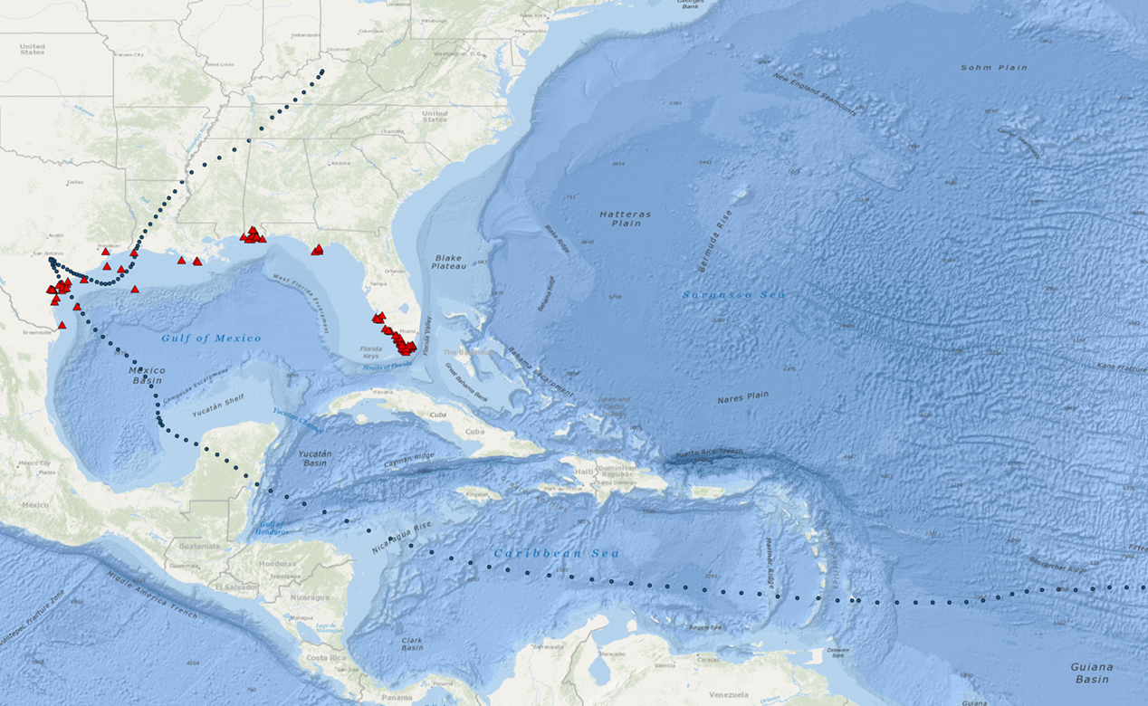
Project Data Sources
Data Retrieval
.csv data:
Gulf of Mexico Coastal Ocean Observing System
http://data.gcoos.org/waf.php
National Hurricane Center
https://www.nhc.noaa.gov/data/tcr/AL092017_Harvey.pdf
-Utilized data, created a csv for Harvey track
API:
GMaps
https://cloud.google.com/maps-platform/

Slide 5
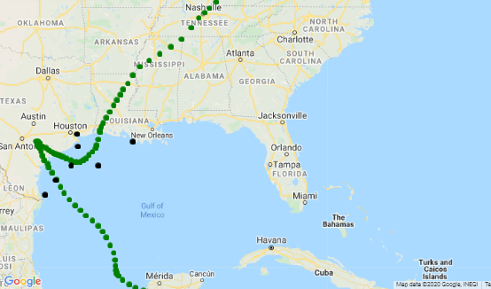
Project Data Point Locations
Selected Data Points:
A = 42043
B = 42044
C = 42047
D = 8764314
E = 8770613
F = TABS-X
G = 42019
E
A
D
G
C
F
B

Slide 6
Data Cleanup
The GSOOS site referenced previously was scanned for availability of .csv data. The Harvey path was cross-referenced for general location. The seven locations shown contained the most complete data sets in regard to attributes that could be studied:
Wind speed was considered dependent variable.
Salinity, air temp, water temp, air pressure were independent attributes to be studied.
Rebel Reza’s badass cleaner worked here….
Stuff and things
Adding
s

Slide 7
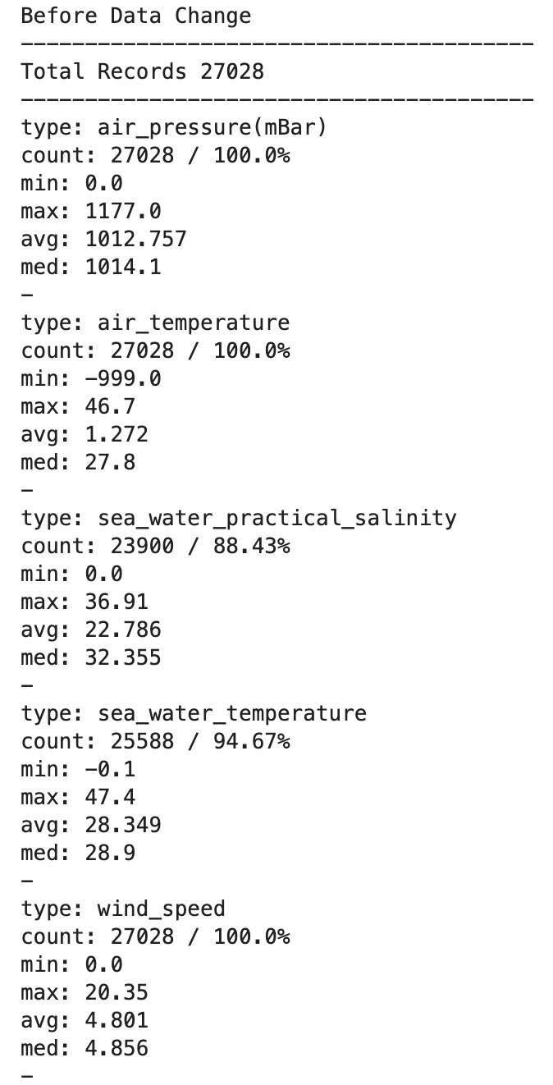
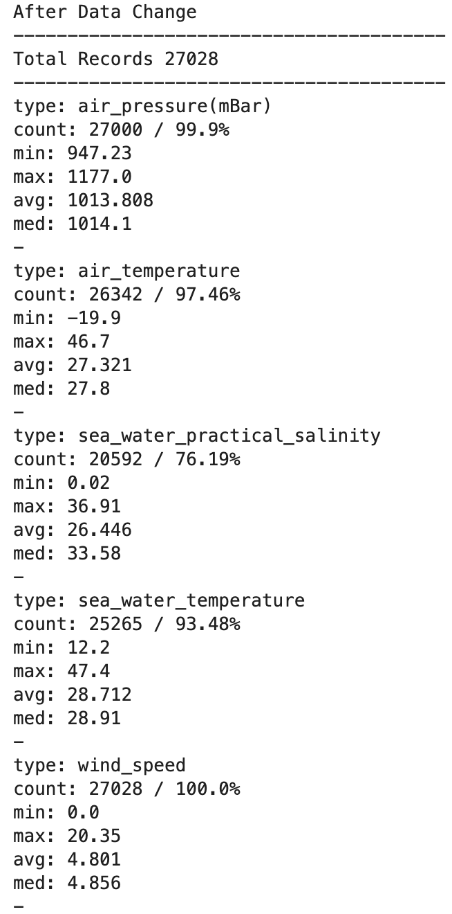
Data Cleanup, Cont.
Small narrative here
Small narrative here

Slide 8
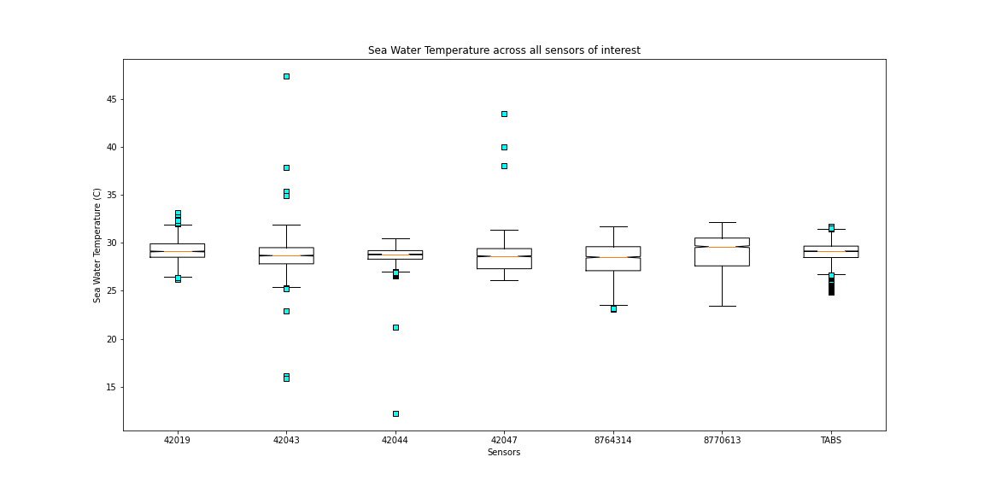
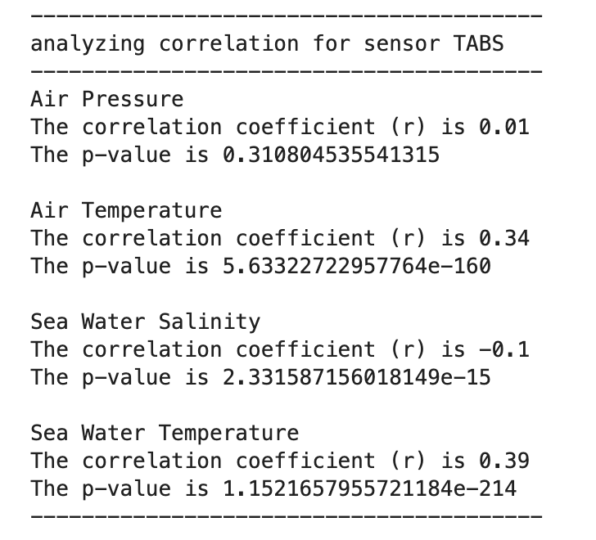
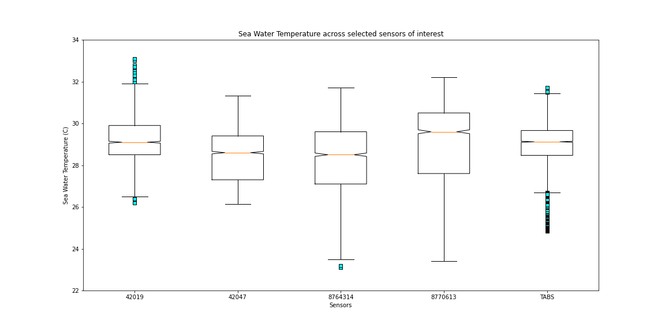
Water Temperature
Data Outliers

Slide 9
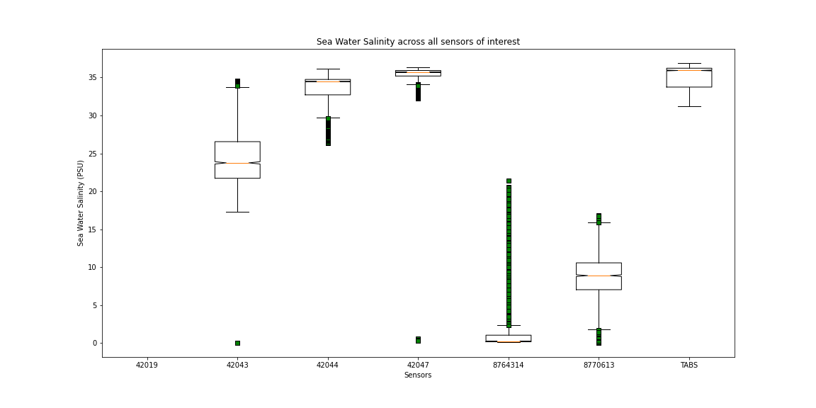
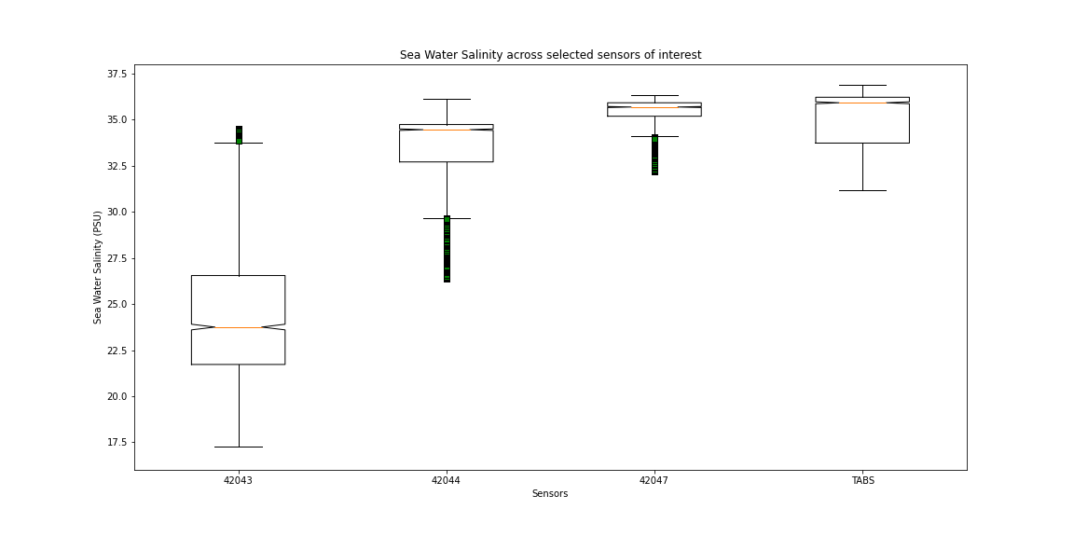
Water Salinity
Data Outliers

Slide 10
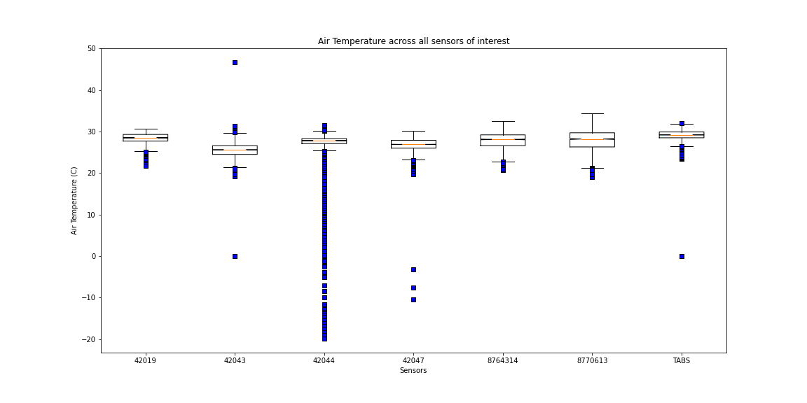
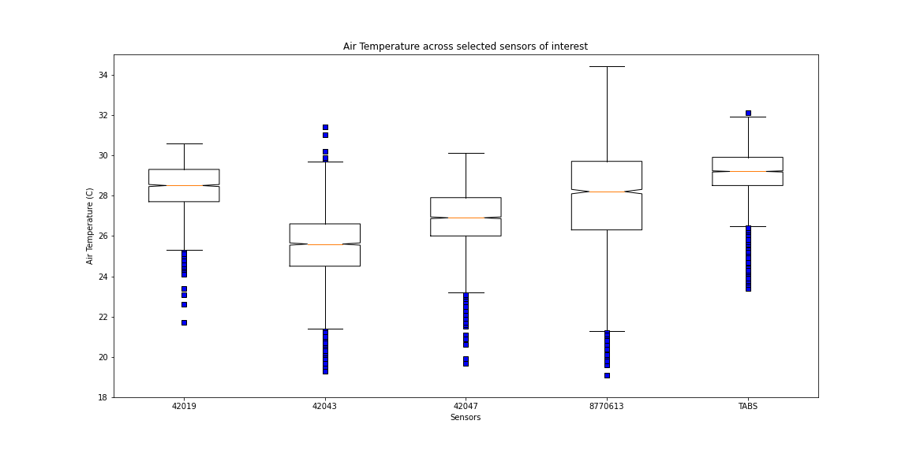
Air Temperature
Data Outliers

Slide 11
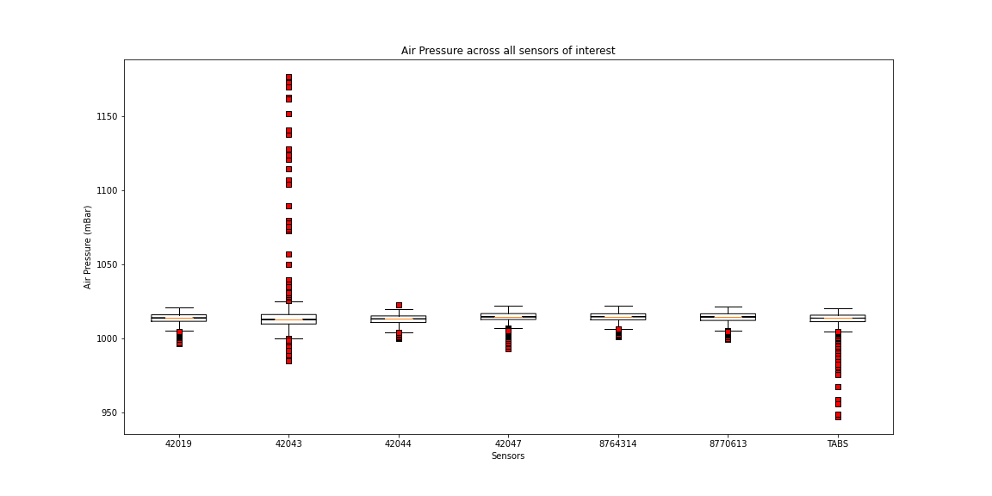
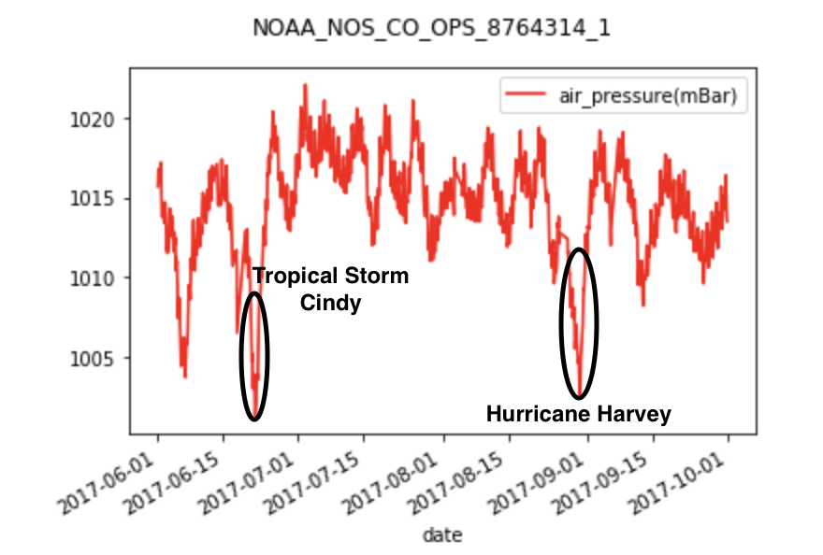
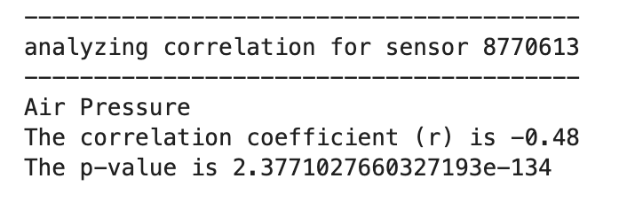
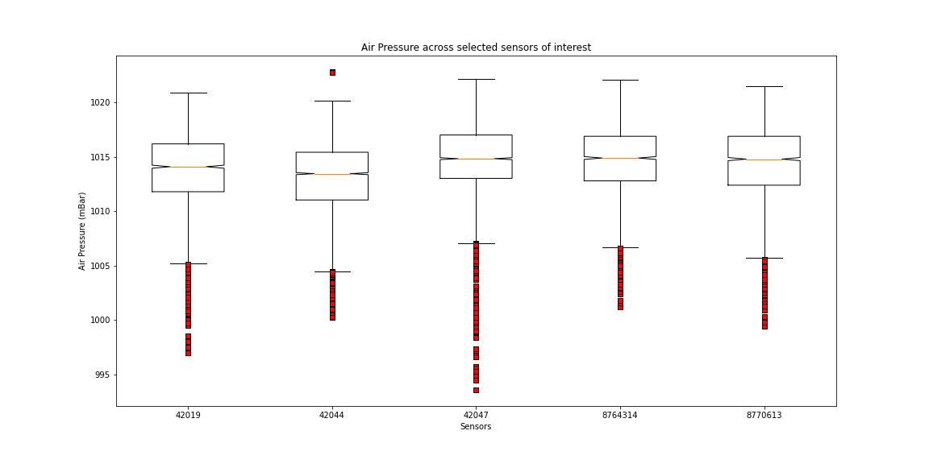
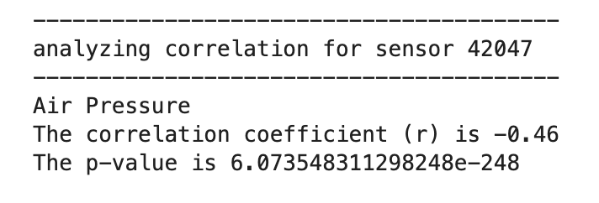
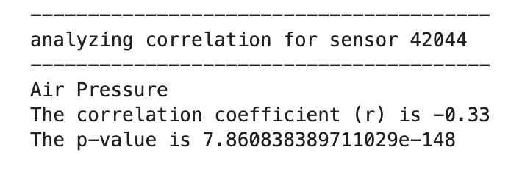
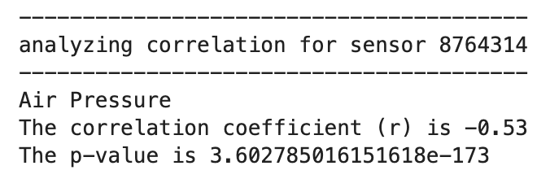
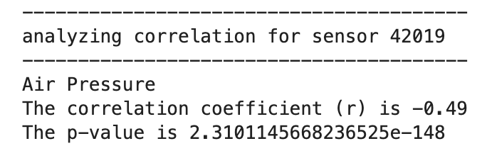
Air Pressure
Data Outliers
Full Data Representation

Slide 12
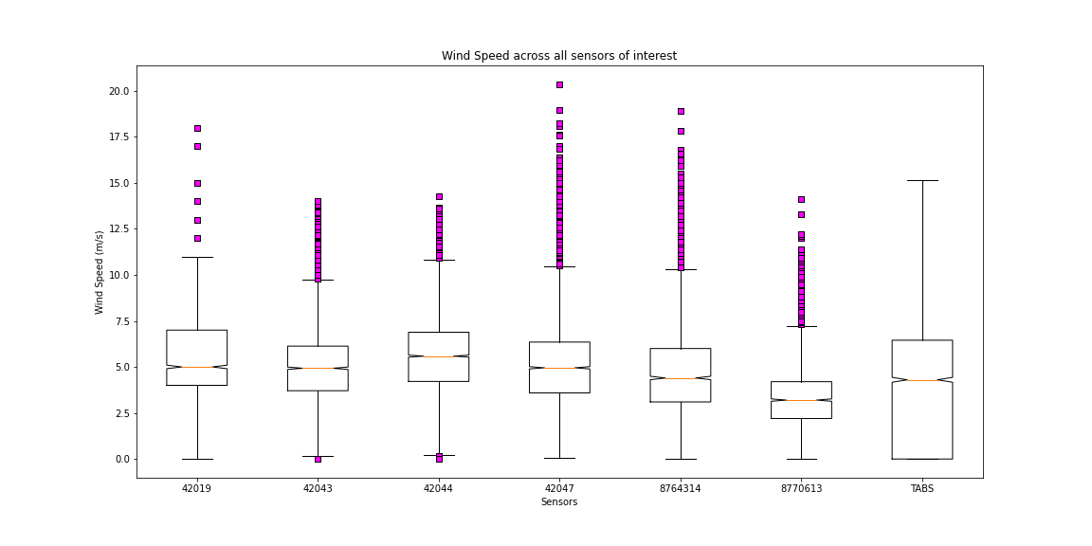
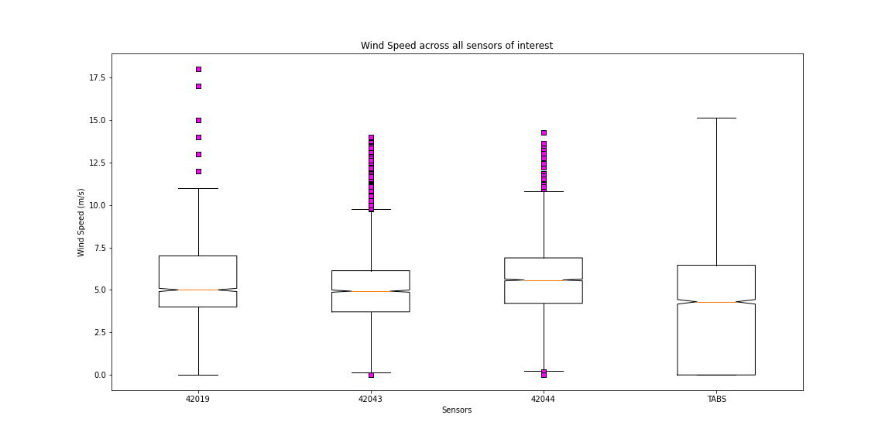
Wind Speed
Data Outliers

Slide 13
Limitations
As is typical for a data project, the group was at the mercy of the available data. Only certain platforms/weather stations acquired the point useful for analysis that lie in a vicinity of the path of the storm.
Even as useable sites were located, as the project progressed, it was found that there were several levels of incompleteness regarding the gathered data sets. For example:
Inconsistency of sensor data acquisition by location and time.
Sensor calibration.
Missing data.
Erroneous data on some the data sets during the actual Hurricane.
Several instances of incomplete data during the storm.
X,Y,Z data was particularly incomplete.

Slide 14
Conclusions

Slide 15
Findings

Slide 16

Questions

